Slide 1
NMBP-03-2016

Slide 3
Horizon 2020
Experience of an EU scientist from collaboration with USA
Some thoughts of collaboration in the Framework of H2020
Dr. Dimitrios Niarchos, NCSR Demokritos, Greece
d.niarchos@inn.demokritos.gr
Research and
Innovation

Slide 4
Three priorities:
Excellent science
Industrial leadership
Societal challenges

Slide 5
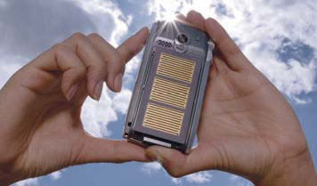
Innovation from Materials
Material innovations can be used in practically all technology sectors and branches of industry.
Some 70 percent of all technical innovations
hinge directly or indirectly on the properties
of the materials they use.
Material innovations have the potential to reduce environmental pollution, save energy, conserve resources, make mobility less dangerous and improve the quality of our life.
Source: ACATECH, 2009,
http://www.research-in-germany.de/dachportal/en/downloads/download-files/9554/high-tech-strategy-2006-112-pages-.pdf

Slide 6
Impact of Advanced Material Technology
Impact of advanced material technology on ICT, Energy &
Biotechnology
(% growth attributable to advanced materials)
 | 1970 | 1980 | 1990 | 2000 | 2010 | 2020 | 2030
ICT | 15 | 25 | 40 | 55 | 65 | 75 | 85
Energy | 10 | 15 | 30 | 45 | 55 | 65 | 70
Biotechnology | 5 | 10 | 20 | 30 | 45 | 55 | 65
Advanced materials have an earlier & greater impact in
ICT (incl. electronics),
followed by Energy (incl. construction)
and Biotechnology (incl. health)
Source: Sanford M. Moskowitz, « The Advanced Materials Revolution », John Wiley & Sons Inc, 2009

Slide 7
Categories
Energy
Environment
Health
ICT
Transport
Cross-cutting
Others / Networking
Limits
Cross-cutting: difficulties to decide on a particular category
Field of research versus categories of application

Slide 8
I am here because: NANOPERMAG REFREEPERMAG MIRACLE MAGNETS
1985- Peak of Permanent magnet NdFeB
One of the pioneers was Prof. G. Hadjipanayis
CEAM – Concerted European Action on Magnets
Initiated activity on PMs- Discovered RFe_{12-x} M_{x} N_{y}
Worked on RE₃Fe_{29-x} M_{x}
Involved In three more projects
2012- COORDINATOR OF REFREEPERMAG

Slide 15
UNIVSRTITY MARYLAND
NIST, U of BOCHUM

Slide 17
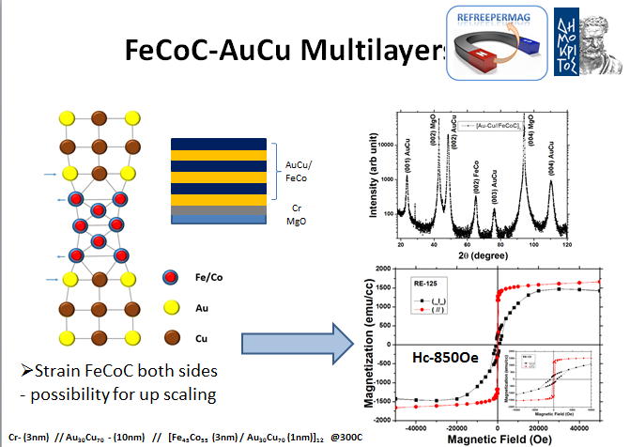
We are the first in the world to achieve this Coercivity, but…

Slide 20
We are the first in the word to operate a motor with MnBi magnets…

Slide 21
Spillovers of previous engagement
New application NOVAMAG NMP-23
(sustain at EU PM activity)
Microwave assisted synthesis-sintering
Spin-off AMEN TECHNOLOGIES

Slide 22
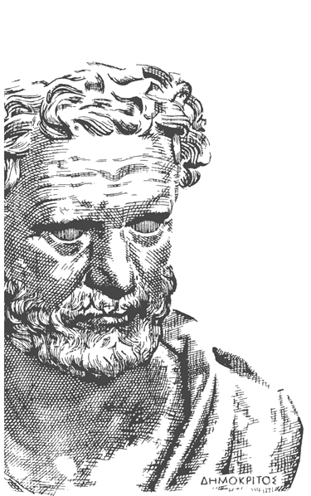

Slide 23
I am here because: NANOPERMAG REFREEPERMAG MIRACLE MAGNETS
U of Pennsylvania
U of Delaware
P. Dent EEC, 2012
Amen Technologies Greece http://www.amen-technologies.com/

Slide 24
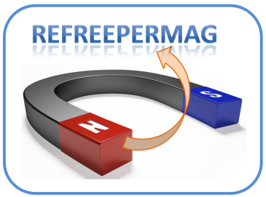
Future work-Suggestions
Towards re-engineering of the grain Boundaries – Less Dy NdFeB
In minutes rather hours!!!
Amen Technologies Greece http://www.amen-technologies.com/
MQ-2010

Slide 25
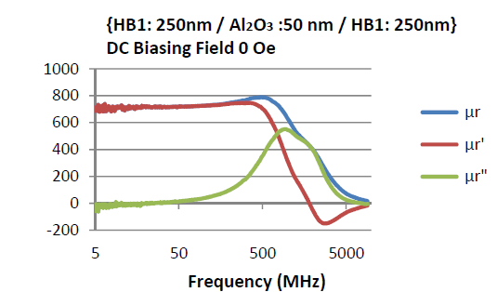
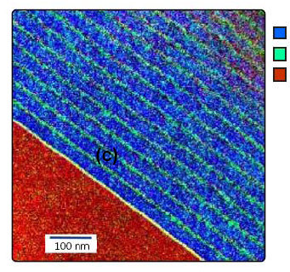
I am here because: HF Magnetics for DC-DC converters
A. Majumbar, MRS-2013 SF Google Priority, Enpirion Inc
MRS2013-Spring Meeting
Top Priority HF Magnetics for DC-DC converters

Slide 26
I am here because: To suggest
the following
Collaboration in :
Materials by Design!!! Multiscale modeling (NIST ann Today)
Combinatorial Synthesis and screening
Materials genome!!! Synthesis of “Phase
Diagrammes” using “Bottom-up building blocks”
Establish SBIR-type programmes in EU
Support Specialized Workshops and brainstorming Sessions

Slide 27
Thank you for
your attention!

Slide 28
Contact details
Contact person | Dr. Dimitrios Niarchos
Organisation | INN, NCSR Demokritos
Adress | Terma Neapoleos 1, Aghia Paraskevi, Attikis 15310, Athens, Greece
Phone nr | + 30 2106503385
E-mail | d.niarchos@inn.demokritos.gr

Slide 29
I am here because: HITEMAG and TERAMAGSTORE (EU Projects)
Need for Ultrahigh Magnetic Recording > 1 Tbit/cm²
Late nineties G. Hadjipanayis, UDEL
D. Sellmyer + U Nebraska
D. Niarchos , NCSR Demokritos
Organized Workshops and NATO schools on Recording Media in the 90’s and early 2000.
I grabbed the opportunity, established an activity and 10 years later

Slide 30
I am here because: HITEMAG and TERAMAGSTORE (EU Projects)
Need for Ultrahigh Magnetic Recording > 1 Tbit/cm²
We obtained funding from EU and Achieved
In 2005 205 Gbits/in² ---- DESCARTES PRIZE 2005
In 2012 > 1 Tbit/in² ---- Among the first in world record teams
Important the contribution from USA scientists, but EU is lacking long term strategy for recording

Slide 31
I am here because: HITEMAG and TERAMAGSTORE (EU Projects)
Unpublished Data-TERAMAGSTOR
> 1 Tbit/in²

